Slide 1




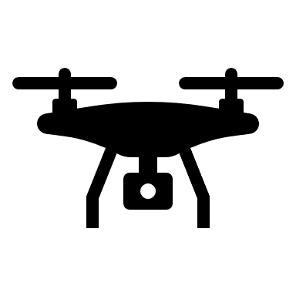
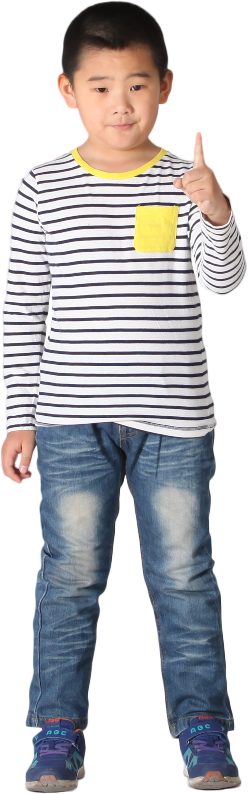
UAV controlled by hand signs
User hand sign
Camera
Raspberry
MQTT server
UAV
Give instruction with hand signs
Capture images
Detect hand in image
Receive instruction from computer
Subscribe to MQTT server
Send images to the Raspberry
Recognize hand sign
Publish instruction
Receive instruction
Send instruction to MQTT server
Execute instruction

